Slide 1
Digital Notice Board using Raspberry pi3
Project Team Members
T.Jayaprakash 15BQ1A1250
D.Anudeep 15BQ1A1211
G.RahulVineth 15BQ1A1214
N.AkhilSai 15BQ1A1239
UNDER THE ESTEEMED GUIDANCE OF
B.Rajesh Assistant professor

Slide 2
ABSTRACT
The Internet of Things (IoT) is the network of physical devices, vehicles, home appliances, and other items embedded with electronics, software, sensors, actuators and network conductivity which enable these objects to connect and exchange data.
Notice Board is the primary thing in any institution or public utility places like bus stations, railway stations, colleges, malls, etc. But sticking various notices day to day is a difficult process. The main objective of this IoT system is to develop a wireless notice board that displays message sent from user. It is simple to design, easy to install, user friendly system, which can receive and display notice in a particular manner with respect to date and time, which help the user to easily keep the track of the notice board every day.
The project is built around ARM controller raspberry-pi which is the heart of the system. At any time we can add or remove or alter the text or notices according to our requirement using smart phones, tablets or computers. The raspberry-pi takes the data from the user through internet and displays the same on the notice board.
Keywords: Internet of things; Raspberry Pi; Notice Board; Wireless system.

Slide 3
PURPOSE
Notice Boards are an important medium for displaying information and keeping people aware.
In colleges separate person for pinning or sticking notices on the board and wastage of paper printer-ink etc
We are using raspberry-pi (model B) as transmitter, by using raspberry-pi we can make notices at any time and transmit over internet at receiving end after establishing connection between the transmitter (raspberry-pi) and receiver (LCD screen) by providing IP address, then we are able to send the notices remotely from anywhere in the world.

Slide 4
objective
This idea with an aim to increase the usability of electronic notice boards, deals with wireless reception and display of notices using raspberry-pi.
The internet is used for data transmission that sends notices. We are using raspberry-pi (model B) as transmitter, by using raspberry-pi we can make notices at any time and transmit over internet at receiving end after establishing connection between the transmitter (raspberry-pi) and receiver (LCD screen) by providing IP address, then we are able to send the notices remotely from anywhere in the world.

Slide 5
SCOPE
By using multiple screens for displaying the big size advertising purpose and the contents on the screen is made up of several mage files and broadcasting display information such as highway roads, subways, buses and in bus stations, train and railway stations, shopping malls, city squares, hospitals, conference halls, colleges and schools for displaying notice for student information and displaying all instrumental information for visitors and the same application in industries for displaying notices for useful information to their employees
The IoT can be viewed as an advanced technology that resides on few basic pillars as mentioned below:
Anything is identifiable anytime and anywhere
Anything can communicate at anytime and anywhere
Anything interacts anywhere and at anytime

Slide 6
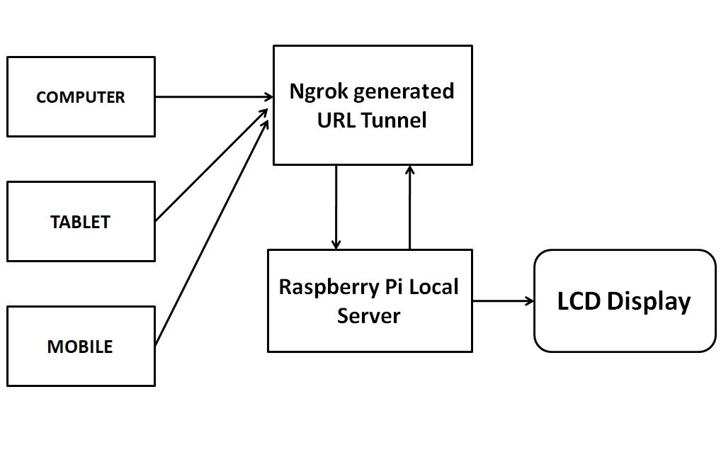
BLOCK DIAGRAM

Slide 7
System Flow Diagram
Installation of Raspberry OS
Installing Virtual Environment Package
Installing Flask Packages

Slide 8
Installing ngork and set up configuration for Terminal
Run the program and get the web URL from ngork
Is Security Key Correct
Stop
Enter Notice To Send
Notice on LCD Display

Slide 9
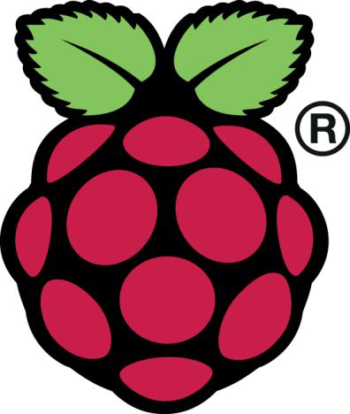
RASPBERRY PI
The Raspberry Pi is a low cost, credit-card sized computer that plugs into a computer monitor or TV and used a standard keyboard and mouse. It is a capable little device that enables people of all ages to explore computing and to learn how to program in languages like Scratch and Python. It is capable of doing everything
The Raspberry Pi is a series of small single-board computers developed in the United Kingdom by the Raspberry Pi Foundation to promote the teaching of basic computer science in schools and in developing countries.

Slide 10
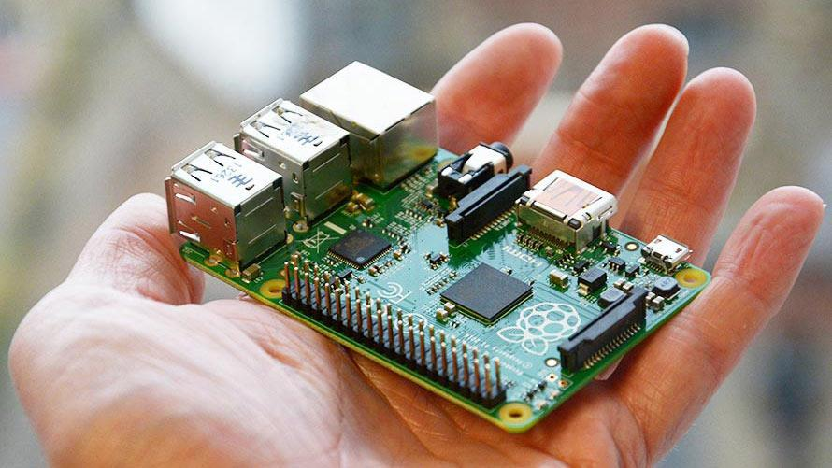
RASPBERRY PI OVERVIEW

Slide 11
REFERENCES
Cuno Pfister “Getting Started With the Internet of Things – Connecting Sensors and Wireless Networks to the Cloud”, Make Projects Publishers, 2011.
P. Bhaskara Chary “An IoT Based Web Page Controlled Notice Board”,
INTERNATIONAL JOURNAL OF INNOVATIVE TECHNOLOGY AND RESEARCH (IJITR), Volume No.5, Issue No.5 , August, 2017, ISSN (print) : 7224 -7225 .
Li, J., Da-You, L., and Bo, Y., “Smart home research, ”Proceedings of the Third International Conference on MachineLearning and Cybernetics, vol. 2, pp. 659– 663, Shanghai,.
Choi, J., Shin, D., and Shin, D., Research on Design and Implementation of the Artificial Intelligence Agent for Smart Home Based on Support Vector Machine, Berlin/Heidelberg: Springer, p. 417, 2005.
Li, B., Hathaipontaluk, P., and Luo, S., “Intelligent oven in smart home environment,” International Conference on Research Challenges in Computer Science (ICRCCS ’09), pp. 247–250, Shanghai.

Slide 12
Advantages
Secure operating system - no need to worry about viruses or Windows error messages
Easy to setup and maintain - no need to continually patch or update
Can be programmed to turn screens off when not in use
No Printing and photocopying costs . Thus saves time . Energy and finally environment.

Slide 13
Applications
Educational institutions & organizations
Managing traffic
Advertisement Conference hall
Bus/Railway station
Any public utilize places

Slide 14
Thank You

